Slide 1


In a lab:
Give your hands a squirt of sanitizer on the way in and the way out
Use the cleaning wipes on your keyboard and mouse - they get gross quickly
Open the windows and doors, bring a jumper!
Safety measures
Get vaccinated
Wear a face covering
Hands, face, space and fresh air
Scan Hallam QR Codes
Take regular tests
Report Covid-19 cases
protect the University and local community, show respect and consideration for others, reduce Covid-19 transmissions, enjoy the full university experience

Slide 2
Introduction to Concurrent and Parallel Systems Semester 1 – Part 2
Dr Sergio Davies <sergio.davies@shu.ac.uk>
Andrew Hamilton <andrew.hamilton@shu.ac.uk>
Department of computing
Sheffield Hallam University
30 September 2021
Notes:
We will discuss now the practical session

Slide 3
TUTORIAL: Matrix multiplication
Notes:
We’ll focus around the topic of matrix multiplication

Slide 4
Why matrix multiplication
The topics covered in CAPS may be linked to many applications
Someone may like application A;
Someone else may like application B;
Module will not be tied to a specific application, as there are too many possibilities;
Matrix multiplication is a simple parallelisable algorithm used for:
Photo editing: image filters are applied through matrix multiplication;
Gaming field: applying filters or moving camera in games;
Artificial intelligence: neural networks are simulated by the use of matrices and multiplication between them;
Quantum mechanics and physics computations;
Mathematical finance (e.g. correlations between two financial instruments);
Notes:
Why matrix multiplication?
In general concurrent programming may be linked to many practical applications. Someone may be interested in application A, someone else may be interested in application B. We will not link this module to one single specific application, but we will keep it as general as possible.
Matrix multiplication is a simple parallelisable algorithm that is common among many different practical application.
In photo editing, filters are applied using matrix multiplication
In gaming, graphical filters are applied using matrix multiplication
In artificial intelligence, neural networks are simulated by using matrix multiplications
Quantum mechanics and physics computation often involve matrix multiplications
Mathematical finance often requires matrix multiplications to compute, for example, the correlation between two instruments

Slide 5
1 – When is it possible?
Notes:
Let’s start talking about this algorithm.
First of all, when is it possible to multiply two matrices?

Slide 6
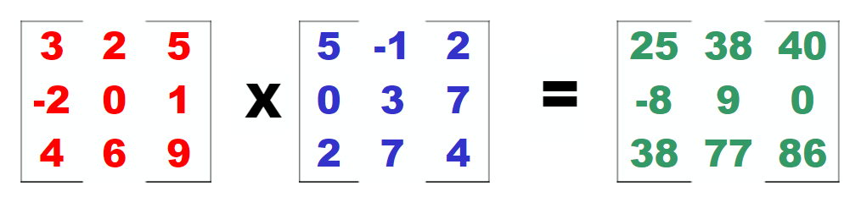
Matrix dimensions
Example 1
3 x 3
3 x 3
Notes:
Let’s start with a simple example: two three-by-three matrices. Do you think these two matrices can be multiplied? What size will the resulting matrix have?

Slide 7
Matrix dimensions
Example 1
3 x 3
3 x 3
3 x 3
Notes:
You guessed correctly if you though that the resulting matrix is also three-by-three

Slide 8
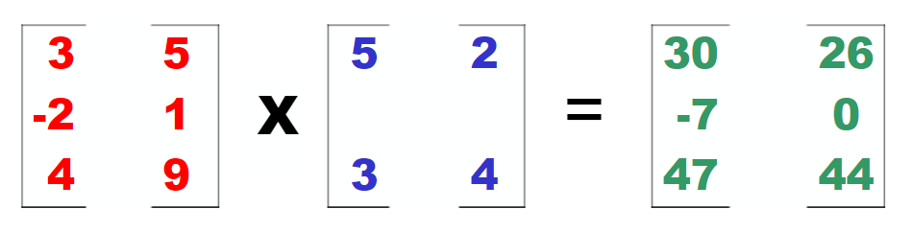
Matrix dimensions
Example 2
3 x 2
2 x 2
Notes:
Now, a slightly more complex example.
Can these two matrices be multiplied? And if yes, what is the size of the resulting matrix?

Slide 9
Matrix dimensions
Example 2
3 x 2
2 x 2
3 x 2
Notes:
In this case, not all the dimensions are the same, so we consider the two marked by the blue box. If these two dimensions are the same, then the two matrices can be multiplied. In this case they are, so the resulting matrix will have the number of rows from the first matrix and the number of columns from the second matrix

Slide 10
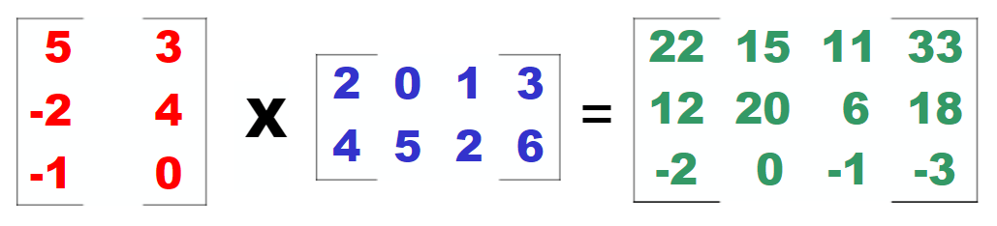
Matrix dimensions
Example 3
3 x 2
2 x 4
Notes:
A more complex example:
Can these two matrices be multiplied? And if yes, what is the size of the resulting matrix?

Slide 11
Matrix dimensions
Example 3
3 x 2
2 x 4
3 x 4
Notes:
Applying the rule discussed before, the two matrices can be multiplied and the resulting matrix will have 3 rows and 4 columns

Slide 12
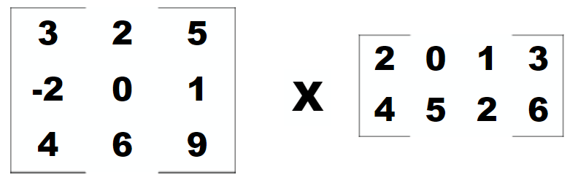
Matrix dimensions
Example 4
3 x 3
2 x 4
Notes:
Can these two matrices be multiplied? And if yes, what is the size of the resulting matrix?

Slide 13
Matrix dimensions
Example 4
3 x 3
2 x 4
Notes:
No, they cannot be multiplied!
In fact, the number of columns of the first matrix and the number of rows of the second matrix are not the same. So the operation cannot be performed.
So when your software will receive the two matrix to be multiplied will need to check the matrix dimensions to ensure that the operation can be performed

Slide 14
2 – How to compute it?
Notes:
How is the multiplication performed?

Slide 15
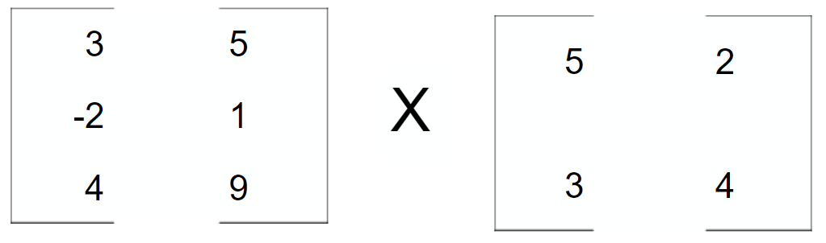
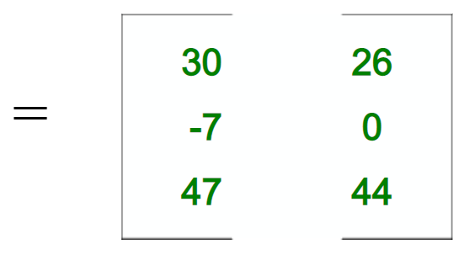
Executing the multiplication
Notes:
Let’s start with this example. Simple one, but which helps getting the point across.
Can these two matrices be multiplied? What are the dimensions of the resulting matrix?
Answer: Yes, they can be multiplied, the resulting matrix will be three-by-two

Slide 16
Executing the multiplication
Notes:
So after we determined that the two matrices can be multiplied, let’s start the multiplication algorithm, let’s select the first row of the first matrix and the first column of the second matrices. In general you always select rows from the first matrix and columns from the second.

Slide 17
Executing the multiplication
3 x 5 + 5 x 3 = 30
Notes:
Let multiply the terms as highlighted: the first element of the row with the first element of the column and the second element of the row with the second element of the column. The two results are then added.

Slide 18
Executing the multiplication
3 x 5 + 5 x 3 = 30
Notes:
The resulting value is the element in first row and first column: these are the row and column used for the operation in the source matrices

Slide 19
Executing the multiplication
Notes:
Once computed the first element, let’s move to the second element: First row, second column.

Slide 20
Executing the multiplication
3 x 2 + 5 x 4 = 26
Notes:
The operation performed between these two is exactly the same as before, just with different numbers.

Slide 21
Executing the multiplication
3 x 2 + 5 x 4 = 26
Notes:
The result goes in the element in the first row second column, as the row and column selected in the source matrices

Slide 22
Executing the multiplication
Notes:
And we continue like this for all the elements in the destination matrix. The algorithm is very simple, but requires many iterations to compute all the elements. Here we multiply the second row by the first column

Slide 23
Executing the multiplication
-2 x 5 + 1 x 3 = -7

Slide 24
Executing the multiplication
-2 x 5 + 1 x 3 = -7

Slide 25
Executing the multiplication
Notes:
The second row multiplied by the second column

Slide 26
Executing the multiplication
-2 x 2 + 1 x 4 = 0

Slide 27
Executing the multiplication
-2 x 2 + 1 x 4 = 0

Slide 28
Executing the multiplication
Notes:
The third row multiplied by the first column

Slide 29
Executing the multiplication
4 x 5 + 9 x 3 = 47

Slide 30
Executing the multiplication
4 x 5 + 9 x 3 = 47

Slide 31
Executing the multiplication
Notes:
The third row multiplied by the second column

Slide 32
Executing the multiplication
4 x 2 + 9 x 4 = 44

Slide 33
Executing the multiplication
4 x 2 + 9 x 4 = 44

Slide 34
Tutorial session
Develop a software which computes the matrix multiplication
Read source matrices from file;
Each file specifies the matrix dimensions in the first two numbers, then all the matrix values
Check if the two matrices can be multiplied;
Perform multiplication;
Write resulting matrix to file;
The destination file needs to contain the resulting matrix size, then all the resulting values in some order (e.g. by row)
Notes:
So, now it is your turn to develop some software: write a piece of code that performs the matrix multiplication algorithm. In this case, we need to do it sequentially: no concurrency required at the moment.
The source matrices can be read from a file. The file needs to contain as initial two numbers the matrix dimensions, then all the numbers in the matrix ordered by row.
Once both the matrices are stored in memory, check if the two matrices can be multiplied.
If they can be multiplied, perform the multiplication, and write the resulting matrix to the destination file, using thee same syntax as the source files

Slide 35
Words of wisdom
ALWAYS KEEP COPIES OF EACH VERSION OF THE SOFTWARE YOU PRODUCE They may be needed in later tutorials
(even better if you use a VCS, e.g. git)
Notes:
Words of wisdom: always keep copies of each version of the software you produce.
There will be a moment in the next sessions when you wish to have all of them side-by-side.
Even better if you use some sort of version control system, for example git
I am putting on blackboard the solution to this exercise. I would highly recommend that you write your own solution before looking at mine.

